Slide 1
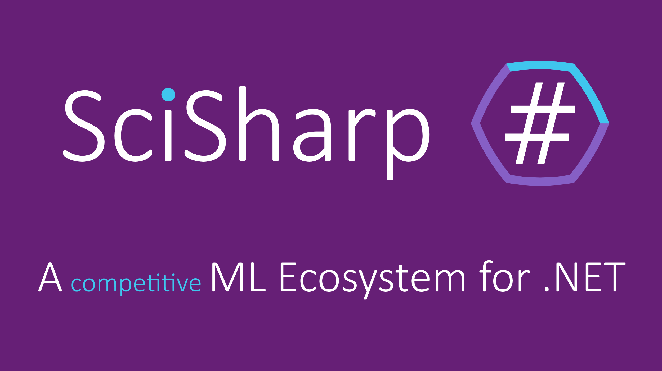
Presentation created by: Meinrad Recheis Speaker: John Ingle
Sliteds

Slide 2

If this is Machine Learning in Python ...

Slide 3

... then this is Machine Learning in C#

Slide 4

The SciSharp stack plans to solve that.
SciSharp is an Open Source Organization
An international team of skilled C# developers
The goal: make major ML frameworks available to .NET community
Notes:
SciSharp STACK's mission is to bring popular data science technology into the .NET world and to provide .NET developers with a powerful Machine Learning tool set without reinventing the wheel.

Slide 5
What‘s so great about SciSharp?
The active and welcoming community
Adapting existing code to .NET is trivial
It‘s statically typed
Great documentation thanks to the nearly perfect porting of existing libraries
Notes:
Since the APIs are kept as similar as possible you can immediately adapt any existing Tensorflow code in C# with a zero learning curve.

Slide 6
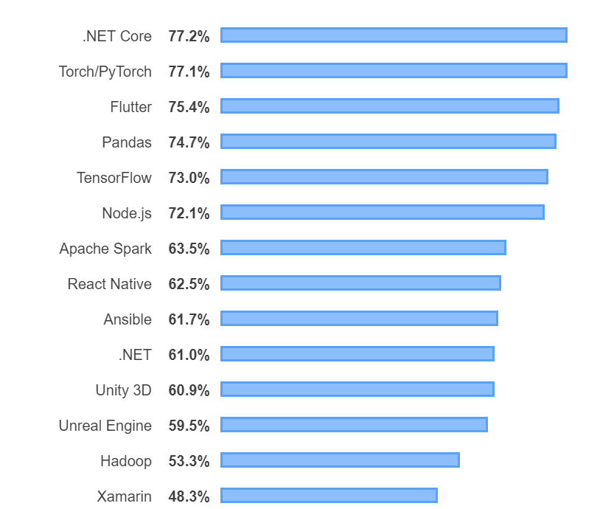
Stack Overflow Developer Survey
„Most Loved Other Frameworks, Libraries and Tools“
Makes sense to bring loved developer tools closer together

Slide 7


Slide 8
A C# port of TF with bindings to the highly efficient C++ CPU/GPU computation layers
Status of TensorFlow.NET
Inference
Training
Building models from scratch in C#
9,330 downloads on Nuget as of August 2019

Slide 9
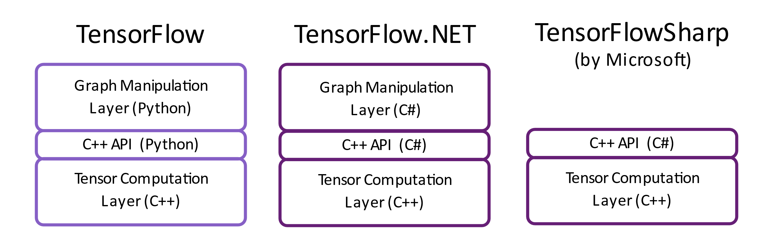
Architecture and Comparison

Slide 10
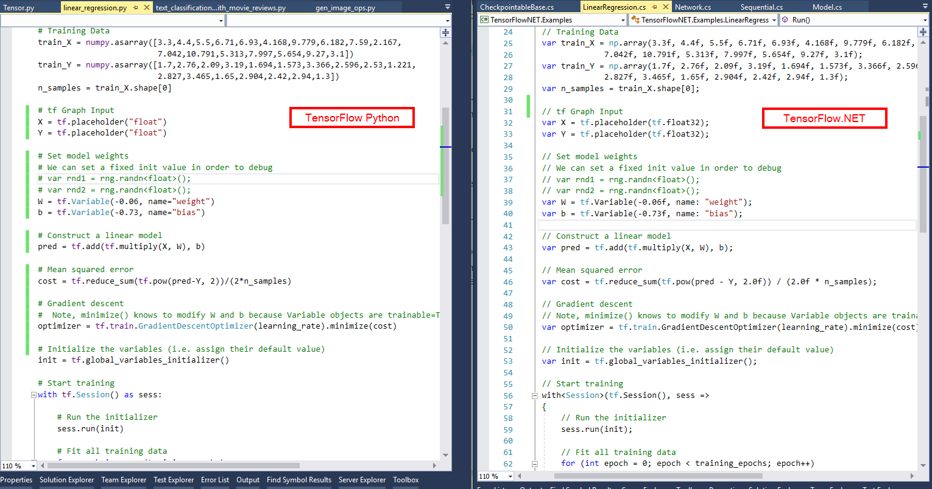

Slide 11


Slide 12
A pure C# implementation of NumPy‘s API with interchangable numerical computation engines
Used by TensorFlow.NET (i.e. for batching)
Implements a large subset of the NDArray API
13,709 downloads on Nuget as of August 2019
No python dependency

Slide 13
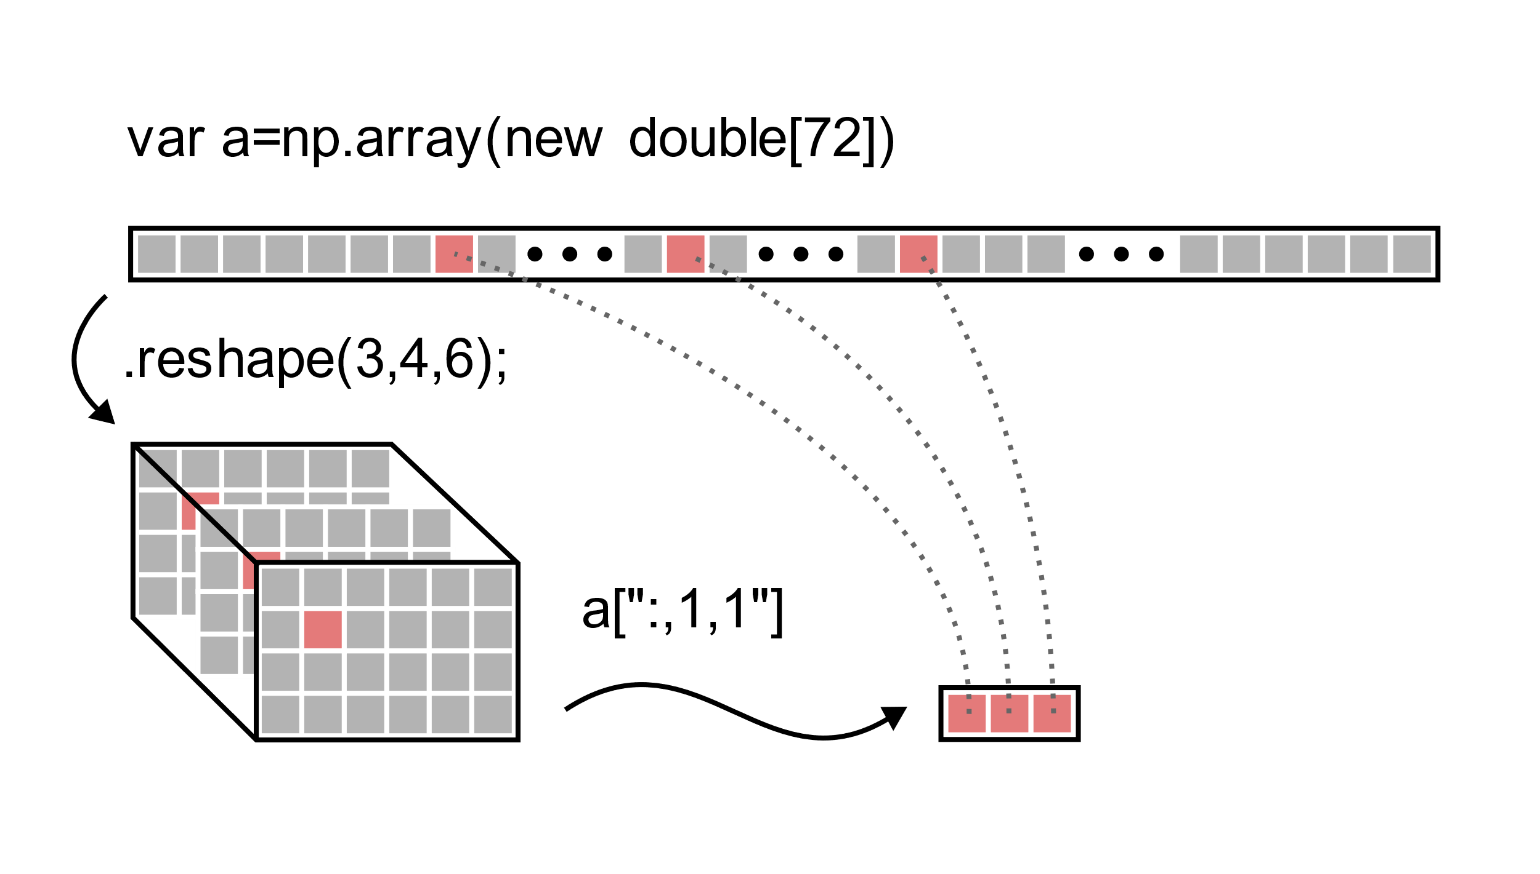

Slide 14
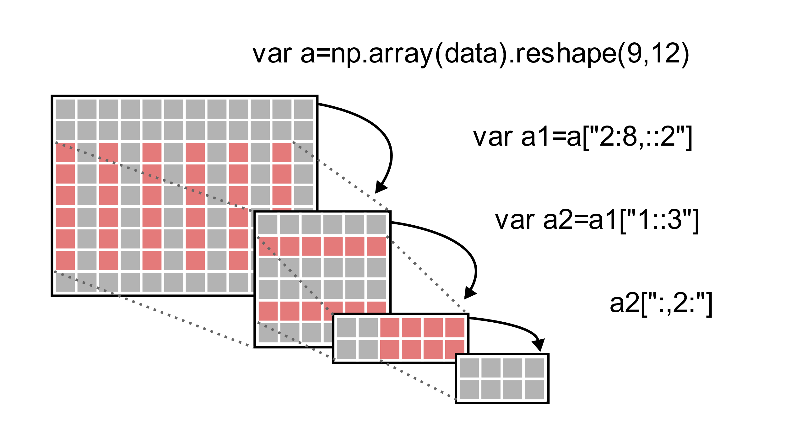

Slide 15


Slide 16
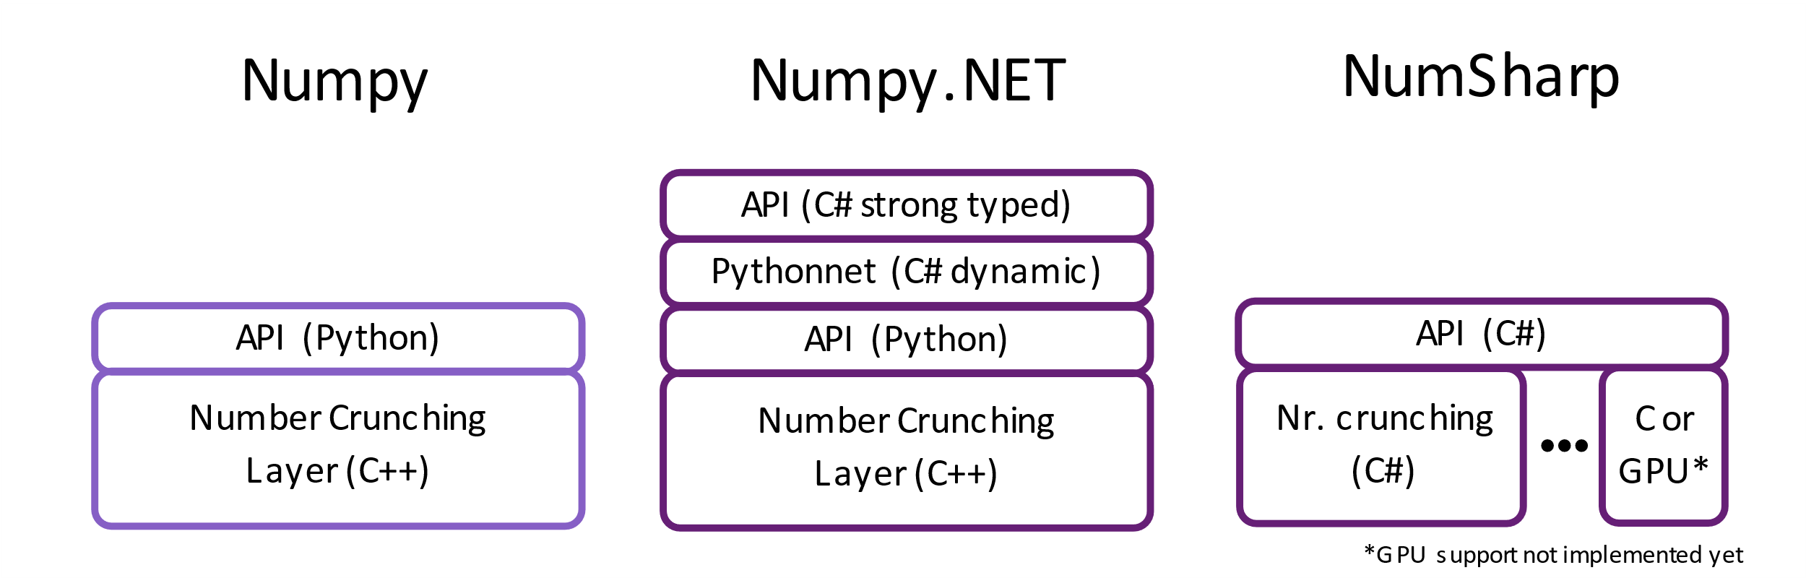
Architecture and Comparison

Slide 17
The most complete .NET bindings for NumPy.
Status of Numpy.NET
Used by Keras.NET and Torch.NET
Auto-generated: implements the complete NDarray API
> 500 API functions

Slide 18


Slide 19
.NET bindings for the high-level NN API running on top of TensorFlow, CNTK, or Theano.
Status of Keras.NET
Mostly auto-generated: implements ~90% of the Keras API
Several working examples published

Slide 20
// Build CNN model
var model = new Sequential();
model.Add(new Conv2D(32, kernel_size: (3, 3).ToTuple(), activation: "relu", input_shape: input_shape));
model.Add(new Conv2D(64, (3, 3).ToTuple(), activation: "relu"));
model.Add(new MaxPooling2D(pool_size: (2, 2).ToTuple()));
model.Add(new Dropout(0.25));
model.Add(new Flatten());
model.Add(new Dense(128, activation: "relu"));
model.Add(new Dropout(0.5));
model.Add(new Dense(num_classes, activation: "softmax"));
model.Compile(loss: "categorical_crossentropy", optimizer: new Adadelta(), metrics: new string[] { "accuracy" });
model.Fit(x_train, y_train, batch_size: batch_size, epochs: epochs, verbose: 1,
validation_data: new NDarray[] { x_test, y_test }); // ← Numpy.NET
var score = model.Evaluate(x_test, y_test, verbose: 0);

Slide 21
More libraries coming soon!
Torch.NET 10k lines of the torch.Tensor API already generated
SpaCy.NET Natural Language Processing
Pandas.NET Time series and structured data analysis
SciSharpCube Docker cube with pre-installed SciSharp tools
ICSharpCore C# plugin for Jupyter Notebook
SiaNet An easy to use CUDA enabled Deep Learning Library
scikit-learn.net C# implementation of scikit-learn
Ludwig.NET Very simple Machine Learning
Gym.NET Reinforcement Learning Environments

Slide 22
Join the Community
Gain deep understanding of a variety of ML/AI frameworks
Make a name for yourself in the Open Source community
Karma ;)
Join the chat on gitter!
https://gitter.im/sci-sharp/community

Slide 23
Thank you
https://github.com/SciSharp

